Slide 1

Intermediate thesis presentation
Optimal operation of CHP’s under uncertainty – Jef Daniëls
Promotor: Pr. Dr. Ir. W. D’haeselaer
Assistant: Juliana Zapata Riveros

Slide 2
Overview
Introduction
Goal
Research questions
Methodology
Semester planning

Slide 3
Introduction – CHP
Separate generation
cogeneration
Fuel
Fuel
Combined Heat & Power
Micro-CHP < 50 kW
Technologies
Stirling
Fuel cell
56%
44%
100%
Power plant
Boiler
CHP
55%
98%
40%
56%
Electricity
Heat
Electricity
Heat
Overall efficiency: 74%
Overall efficiency: 96%
Notes:
CHP: generates simultaneous heat and power -> better overall efficiencies than separate power production

Slide 4
Introduction – Fuel cells
 |  |  | Heat engines |  |  | Fuel cells
1kW-50kW |  |  | ICE | Turbine | Stirling | PEMFC | AFC | PAFC | MCFC | SOFC | DMFC
Power range [kW] |  |  | 1-50 | 10-50 | 1-50 | 1-50 | 10-50 | >50 | >50 | 1-50 | 1-50
Efficiency [%]
 | Electrical 100% load |  | 20-30 | 20-25 | 15-30 | 45 | 50 | 40 | >50 | >50 | 40
 | Electrical 50% load |  | 15-20 | 17-22,5 | 15-30 | 45 | 50 | 40 | 50 | 50 | 40
 | Overall |  | 85-90 | 80-90 | 80-95 | 95 | 80-90 | 80-90 | 80-90 | 95 | 80-90
Capital costs [$/kW] |  |  | 1000-2500 | 1500-2500 | 5000 | <1500 | 1800 | 2100 | 2000-3000 | 3000 | -
Proven track record – Ene-farm Japan
~50 000h; >20 000 units
Fuel cells promise the highest efficiency compared to other micro-CHP’s
Notes:
CHP: generates simultaneous heat and power -> better overall efficiencies than separate power production

Slide 5
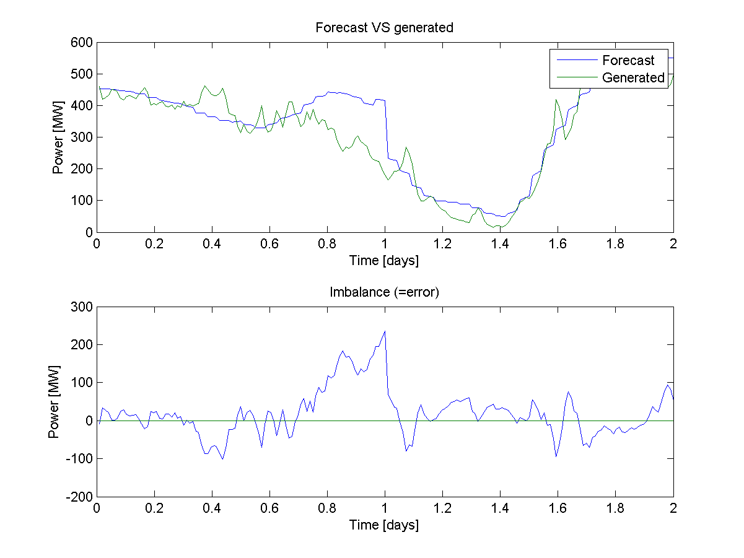
Introduction – Wind uncertainty
Others
Electricity, heat
Wind, solar
Forecasts reduce uncertainty, but errors remain
How can we reduce this error uncertainty?

Slide 6
Goal
Optimal operation of CHP’s under uncertainty
Focus on residential and tertiary fuel cell cogeneration
Focus on wind energy
Virtual Power Plant
Reduce wind forecast error uncertainty with CHP’s

Slide 7
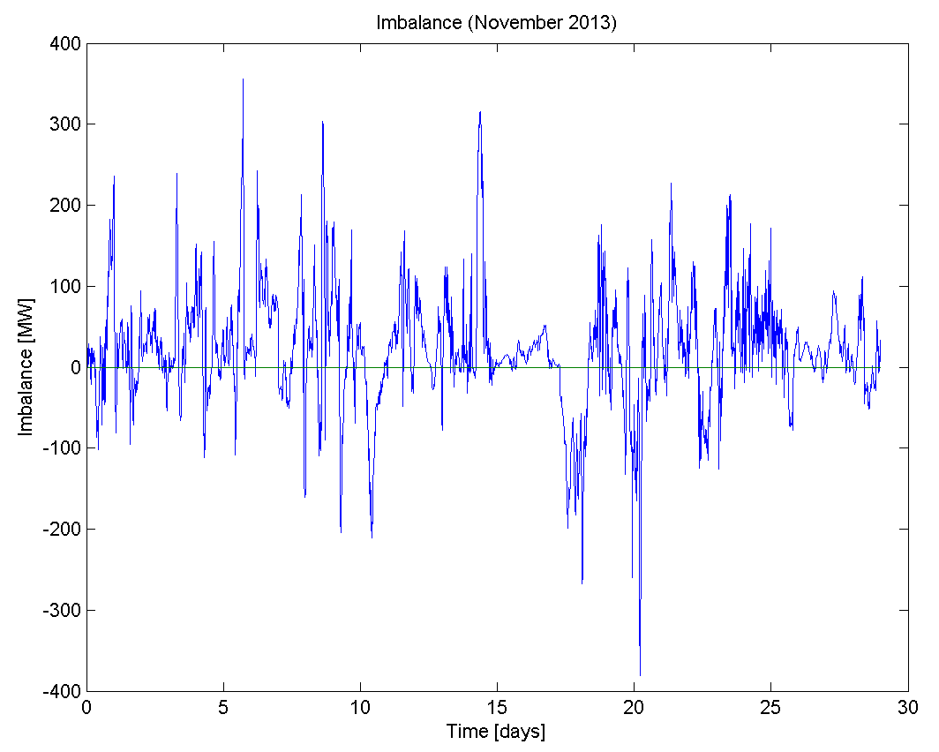
Goal – VPP
Aggregator
Wind turbines
Distributed cogeneration (CHP’s)
(Heat pumps)
Reduce uncertainty by aggregating CHP’s and wind turbines
Notes:
CHP: generates simultaneous heat and power -> better overall efficiencies than separate power production

Slide 8
Goal – Literature
Papers about cost reduction
Lack investment cost
Other way round
Almost no papers about CHP’s to compensate wind error
No papers compare CHP with other techniques (type of uncertainty)
Notes:
CHP: generates simultaneous heat and power -> better overall efficiencies than separate power production

Slide 9
Research questions
What is the cost/type of uncertainty?
Amount of units necessary to reduce this cost?
Profitable investment cost/unit?

Slide 10
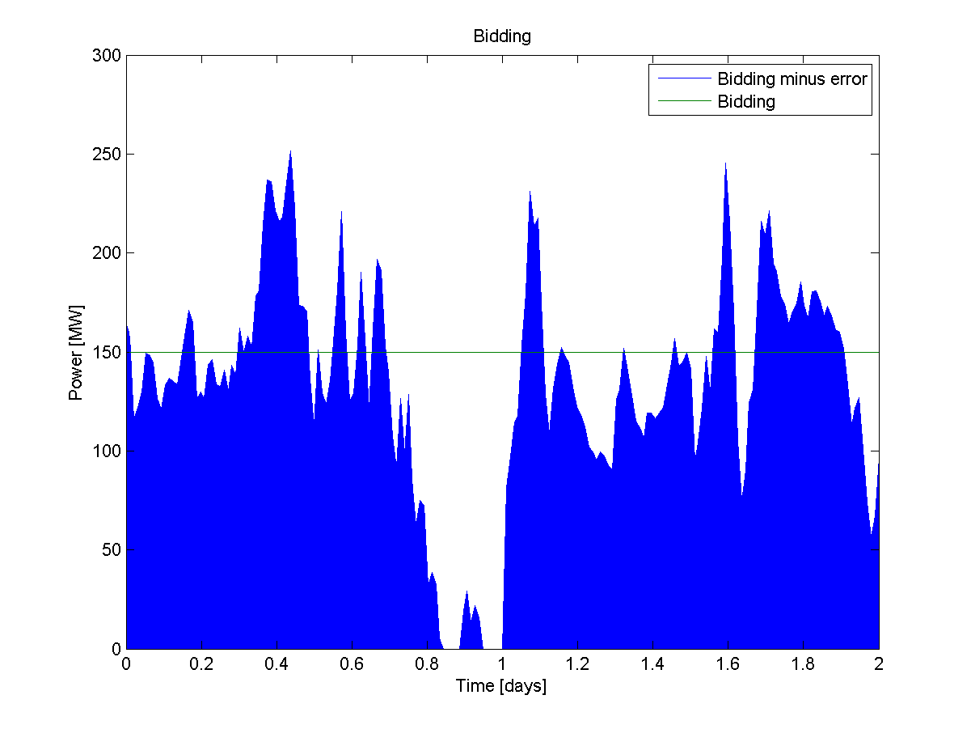
Methodology – Uncertainty
Notes:
We make a bidding, then operate the CHP’s in such a manner that heat demand is met and the imbalance is reduced as much as possible

Slide 11
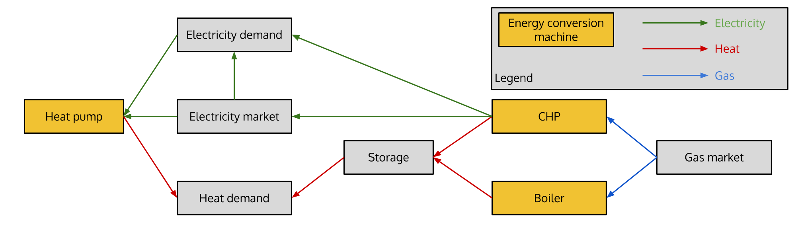
Methodology – Deterministic model

Slide 12
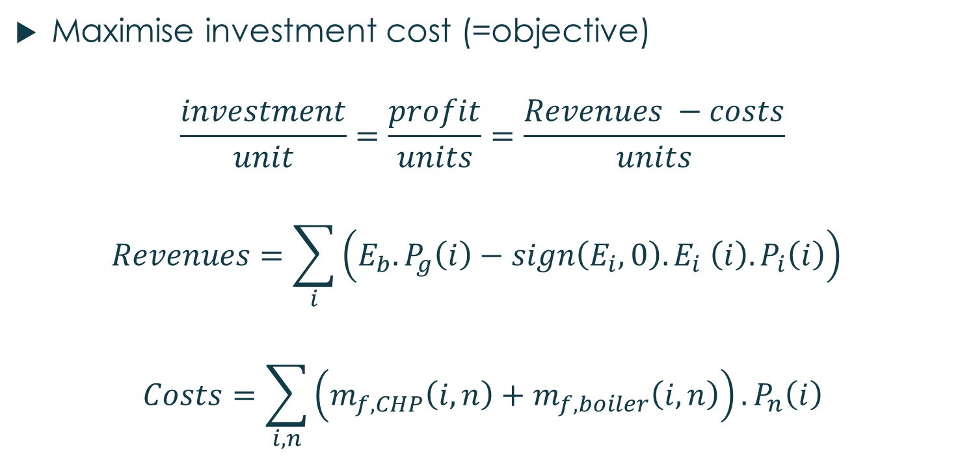
Methodology – Equations
Maximise investment cost (=objective)
$$\frac{investment}{unit}=\frac{profit}{units}=\frac{Revenues −costs}{units}$$
$$Revenues=\sum_{i}{\left(E_{b}.P_{g}\left(i\right)−sign\left(E_{i},0\right).E_{i} \left(i\right).P_{i}\left(i\right)\right) }$$
$$Costs=\sum_{i,n}{\left(m_{f,CHP}\left(i,n\right)+m_{f,boiler}\left(i,n\right)\right)}.P_{n}\left(i\right)$$
Notes:
E = startup cost

Slide 13
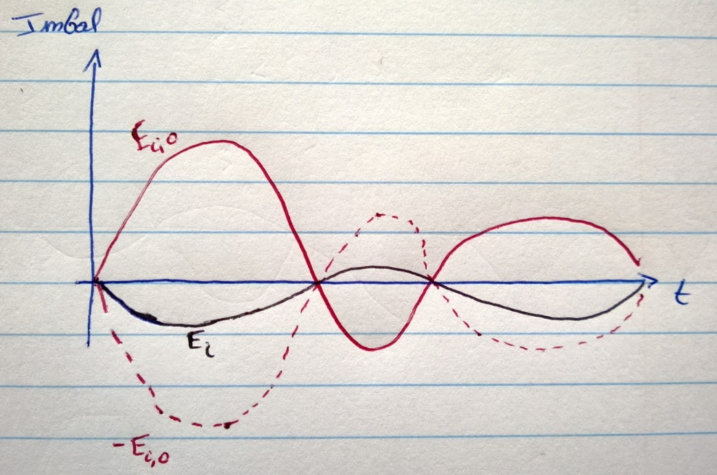
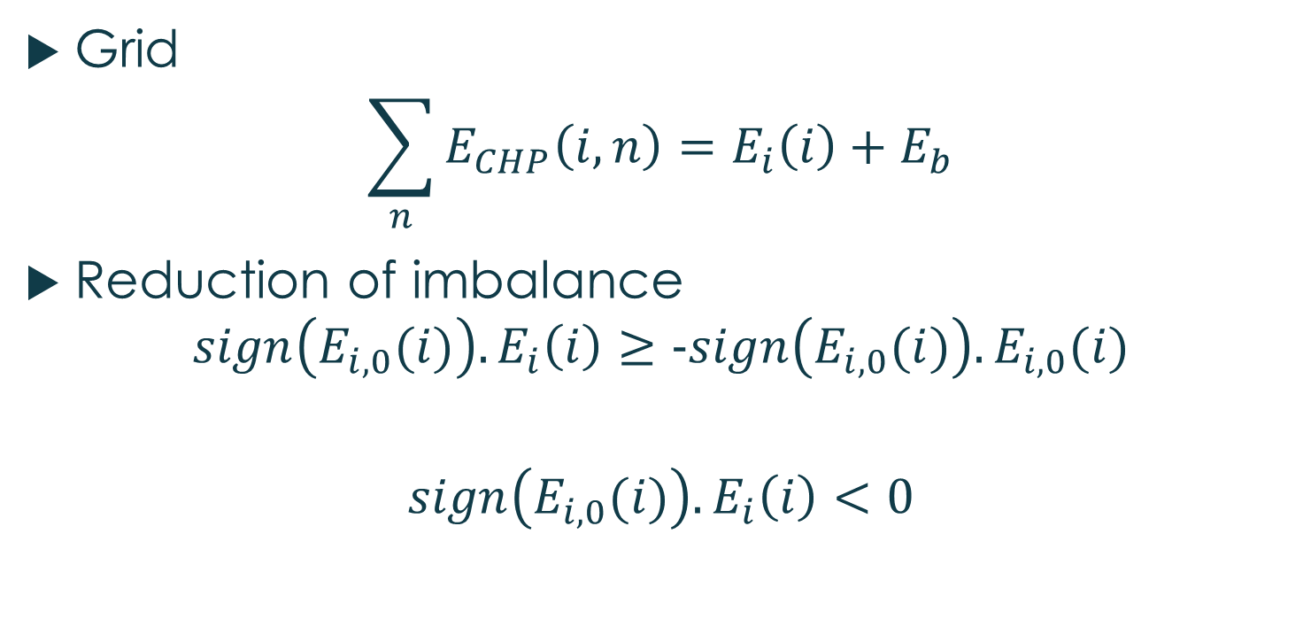
Methodology – Equations
Grid
$$\sum_{n}{E_{CHP}\left(i,n\right)}=E_{i}\left(i\right)+E_{b}$$
Reduction of imbalance
$$sign\left(E_{i,0}(i)\right).E_{i}\left(i\right)≥-sign\left(E_{i,0}(i)\right).E_{i,0}(i)$$
$$sign\left(E_{i,0}(i)\right).E_{i}\left(i\right)<0$$
Notes:
E = startup cost

Slide 14
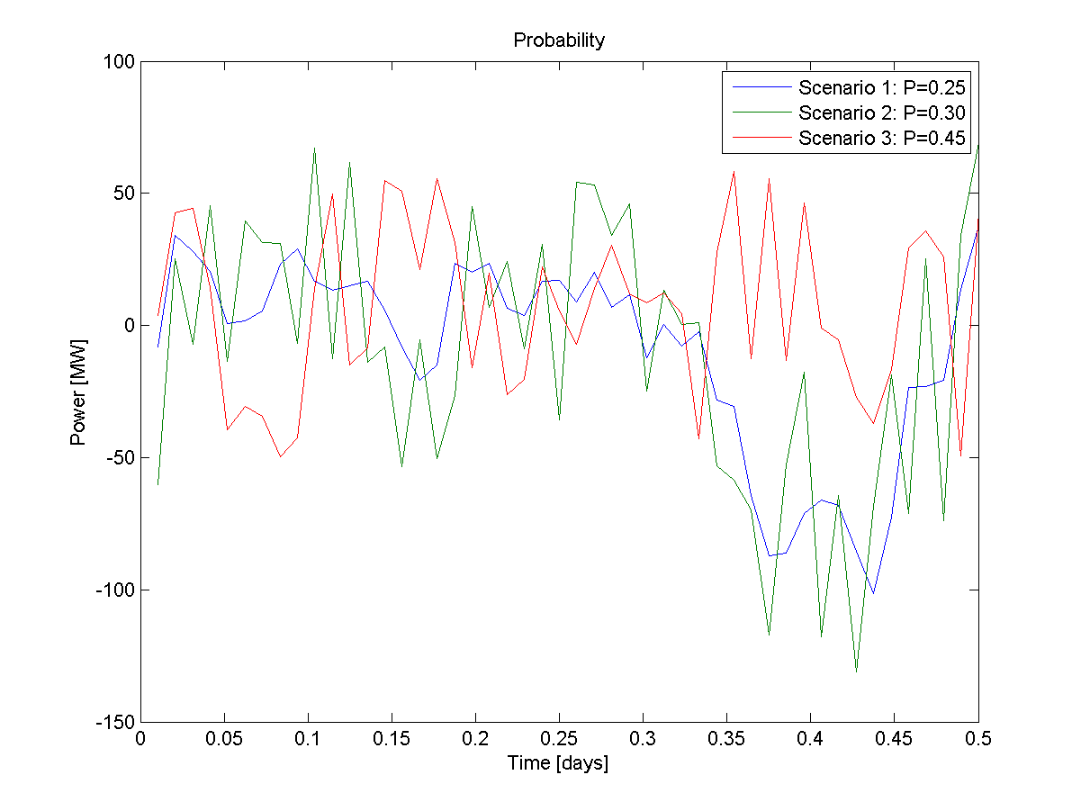
Methodology – Stochastic model
Different error scenario’s
Scenario generation via historical data
Scenario reduction and probabilities
Optimal number of CHP’s required

Slide 15
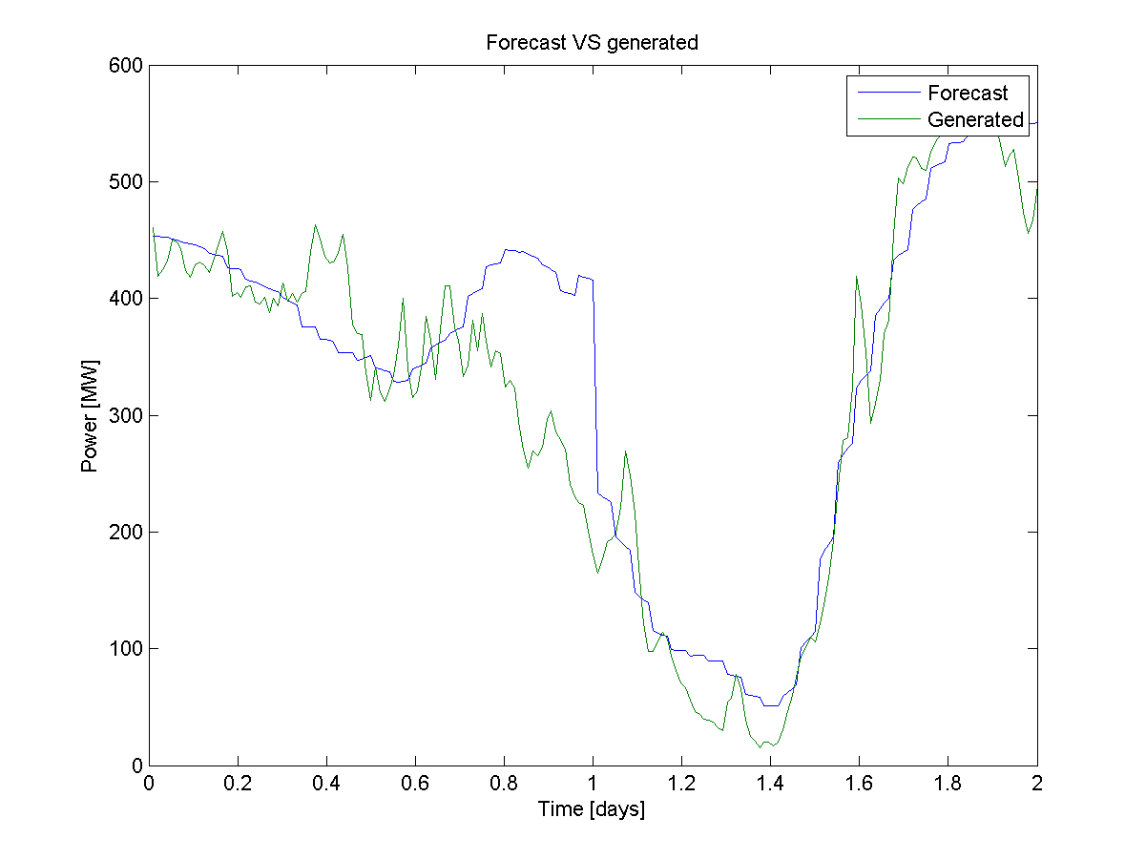
Methodology – Data
Aggregated Belgian data
750MW
Simulate 1MW wind turbine
Order of 10-20kW CHP units
To make results computable

Slide 16
Methodology – Case studies
CHP + boiler (+ battery) → base case
Heat pump + boiler + battery
CHP + heat pump + battery
Decide how many CHP’s required to make minimal investment cost

Slide 17
Semester planning
Deterministic model (end of January)
Stochastic model (end of March)
Scenario generation
Scenario reduction
Developing other case studies (April)
Writing (April)

Slide 18
Goal
Analyse the cost and behaviour of wind uncertainty and the corresponding profitable investment cost for CHP’s and heat pumps

Slide 19
Methodology – Equations
Heat demand = HD
Heat supply = HS
Fuel supply = FS
Elec. Supply = ES
Time = set i
Houses = set j

Slide 20
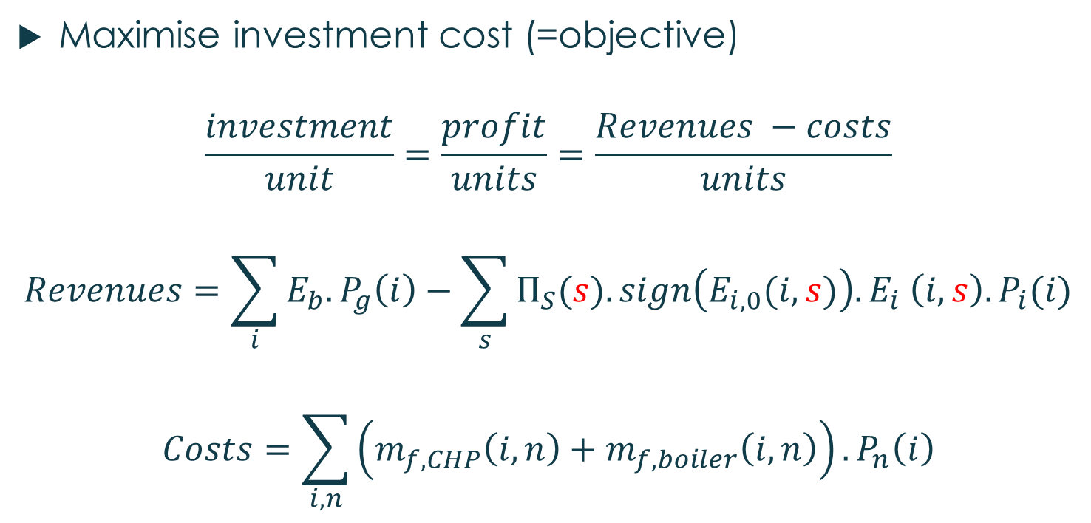
Methodology – Equations
Maximise investment cost (=objective)
$$\frac{investment}{unit}=\frac{profit}{units}=\frac{Revenues −costs}{units}$$
$$Revenues=\sum_{i}{E_{b}.P_{g}\left(i\right)−\sum_{s}{Π_{S}(s).sign\left(E_{i,0}(i,s)\right).E_{i} \left(i,s\right).P_{i}(i)}}$$
$$Costs=\sum_{i,n}{\left(m_{f,CHP}\left(i,n\right)+m_{f,boiler}\left(i,n\right)\right)}.P_{n}\left(i\right)$$
Notes:
E = startup cost

Slide 21
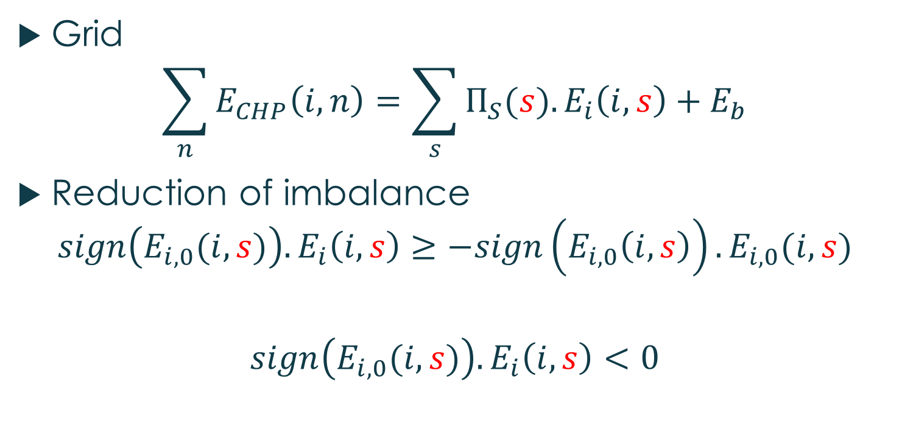
Methodology – Equations
Grid
$$\sum_{n}{E_{CHP}\left(i,n\right)}=\sum_{s}{Π_{S}(s).E_{i}\left(i,s\right)}+E_{b}$$
Reduction of imbalance
$$sign\left(E_{i,0}(i,s)\right).E_{i}\left(i,s\right)≥−sign\left(E_{i,0}\left(i,s\right)\right).E_{i,0}(i,s)$$
$$sign\left(E_{i,0}(i,s)\right).E_{i}\left(i,s\right)<0$$
Notes:
E = startup cost

Slide 22
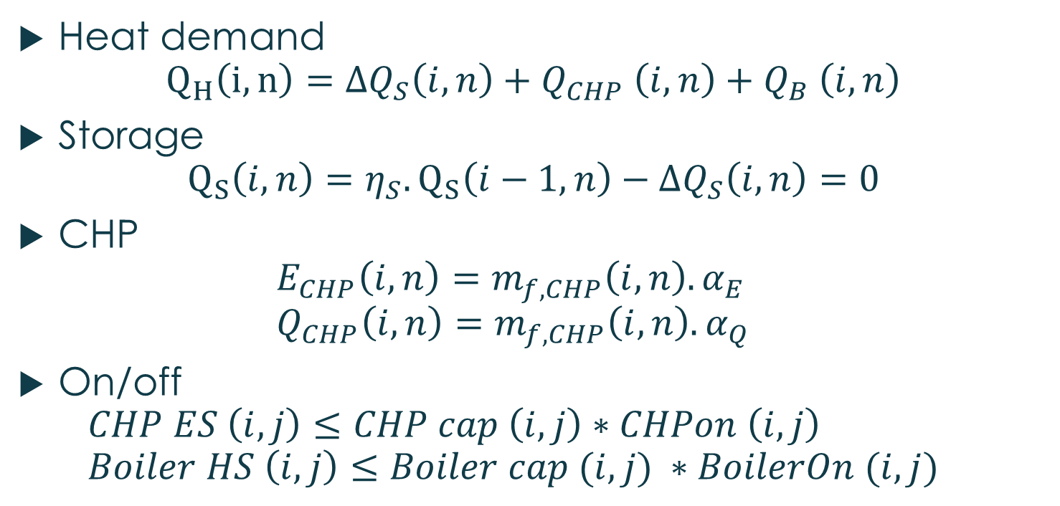
Methodology – Equations
Heat demand $Q_{H}\left(i,n\right)={ΔQ}_{S}\left(i,n\right)+Q_{CHP} \left(i,n\right)+Q_{B} \left(i,n\right)$
Storage $Q_{S}\left(i,n\right)=η_{S}.Q_{S}\left(i−1,n\right)−ΔQ_{S}\left(i,n\right)=0$
CHP $E_{CHP}\left(i,n\right)=m_{f,CHP}\left(i,n\right). α_{E}$ $Q_{CHP}\left(i,n\right)=m_{f,CHP}\left(i,n\right). α_{Q}$
On/off $CHP ES \left(i,j\right)≤CHP cap \left(i,j\right)∗CHPon \left(i,j\right)$ $Boiler HS \left(i,j\right)≤Boiler cap (i,j) ∗BoilerOn (i,j)$

Slide 23

Methodology – Equations
Boiler
$$Q_{B}\left(i,n\right)=m_{f,B}\left(i,n\right).η_{B}$$
HP $pEff∗HP HS \left(i,j\right)=HP ED (i,j)$

